Slide 1
Developer Training
The Component Library

Slide 2

Agenda
Advanced components
Best practices
Hints and tips - components
Hints and tips - templates

Slide 3
Advanced components

Slide 4
Advanced components
To make lists, use the <cp-list> special markup item
  <ul>
  <cp-list name="my_list">
  <li>{text}</li>
  </cp-list>
  </ul>
After saving, you will be able to set min/max counts for your list
The input form will use panels for data entry
Inside the list you can have whatever components you like
  But I strongly recommend that the item inside the list (unless trivial) is a component
You can also nest lists – useful for navigation

Slide 5
Advanced components
For input-only components you can use special markup
  <cp-preview><!--
  {server : Text}
  {folder : Text}
  --></cp-preview>
The cp-preview tag says to only produce any output in preview mode
Then wrap in HTML comments so that nothing is rendered to the browser
Useful for configuration on the site wrapper where output is not required
  Or you can make a layout that doesn’t output anything

Slide 6
Advanced components
Can’t always do what you want with plain markup
For example <h1>{title : Text}</h1>
If the title is empty, you don’t want to render the <h1> tag
Make this field into a Title component
Edit Components_Title.cs (not Components_TitleBase.cs !)
In the output method, put:
  if (asset.Raw[name + "_title" + index] == "") return "";

Slide 7
Advanced components
When customizing code:
name is passed in – as entered on the Template Definition
index is passed in – in case our component is used in a list
"_title" because that’s the our field is called “Title”
  Enter data onto the preview and look at the Content view to find
ALWAYS use both the name and the index
  If not, it may work on preview but might not when used for real

Slide 8
Advanced components
You can do more complex things than simple replacement with blank
For example read OutputBase into a string and manipulate it
  For example consider a component with an image and some descriptive text
  The user gets to choose if the image is on the left or the right
  Use regular expressions to manipulate and rearrange the output… carefully!
You could even ignore the component output entirely and make your own
  But try not to – it’s not always obvious you’ve done this!

Slide 9
Advanced templates

Slide 10
Advanced templates
Component Library is excellent for fixed page layout scenarios
Not yet so good for dynamic pages such as articles, built from sections
Make a Section component and hand-code it to allow a selection of components
  Remember to include input/post_input/output for each
  Let the Component Library do the heavy lifting
  Consider making the available component types configurable to allow reuse
Make a Section List component to allow more than one at a time
Add the Section List component to your template

Slide 11
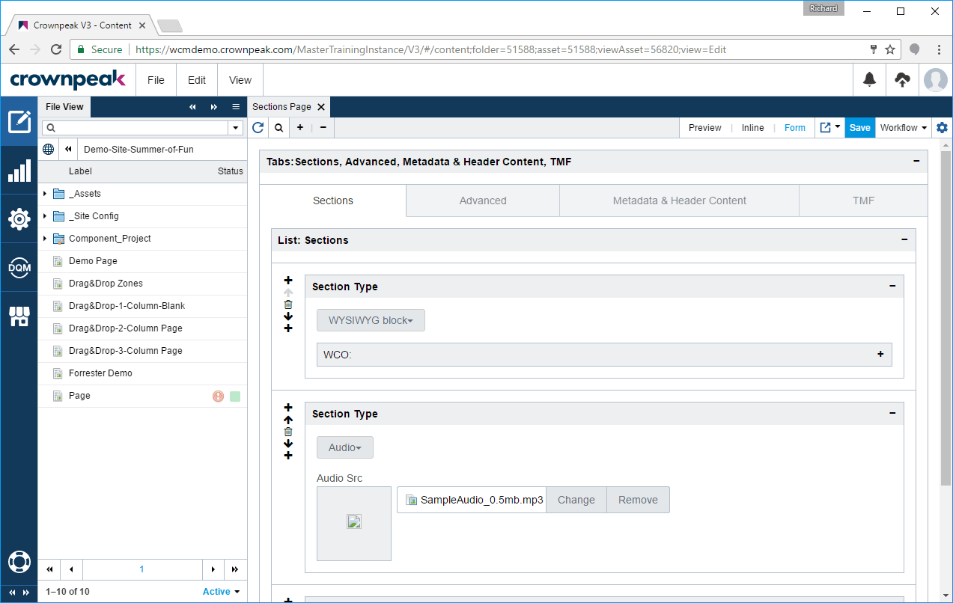
Advanced templates

Slide 12
Best practices

Slide 13
Best practices
Create all components at the same HTML hierarchy level
Create all layouts at the same HTML hierarchy level
Create thumbnails for your components and layouts
  They go in Component Definitions/_thumbnails
  Not mandatory, but a useful visual guide when updating a template
Create models to help authors to create content using your templates

Slide 14
Best practices
Always think about (and test) the input experience with your components
  Not just preview; also test on the template where it will be used
  This is where content authors will spend their day
  It needs to be a nice place to work!
If you want to organize components, use New > Component Folder
  Components can be moved between folders without affecting authors
  If you need to rename them, simpler to delete the classes and recreate
  Don’t forget to backup the code if you customized it!

Slide 15
Hints and tips - components

Slide 16
Hints and tips - components
Watch out for collisions between your component names and .NET classes
  E.g. event, class, date, etc. It’s easy to get caught out!
  Delete the created class files and the component and try again
Code component
  Use {name : Code} to make a field that will be replaced by code
  Enter code into the Component Details Code Snippet field
  Or edit the class file (not the base!) and set a private variable
    Then use this variable in the Code Snippet field
    This is preferable to a huge code snippet in the field – hard to read

Slide 17
Hints and tips - components
If you make complex changes to a component, always Save and Refresh
  Error messages will be big and red and on the first page!
  Remember: they’re not shown until you refresh the form
If you make a pure code component, leave the markup box blank
  Or include a suitable message, so users don’t get confused!
If you make major changes to the output of a component, add a comment
  Help a component developer to understand what to do

Slide 18
Hints and tips - templates

Slide 19
Hints and tips - templates
Never edit the template files that were created by the Component Library
  Input.aspx, output.aspx and post_input.aspx
  They are recreated each time the template is saved
  Post_save.aspx is also created if you’re using the TMF
You can add/edit any other template files as required
  Useful to turn off publishing on templates made by Nav Wrapper Definition

